Slide 1
2015 Conaway Conference
CLAIMS AND DISPUTE RESOLUTION
Nathan Fling
Dispute Resolution & Claims Coordinator

Slide 2
DISPUTES AND CLAIMS
DEFAULT: C&MS 108.02 - PARTNERING
STEP 1 – PROJECT PERSONNEL
STEP 2 – DISTRICT (DDRC)
STEP 3 – DIRECTOR’S CLAIM BOARD (DCB)

Slide 3
DISPUTES AND CLAIMS
Year | # of Claims | # Heard by DCB | # Heard by ADR | # Dropped or Settled
2008 | 21 | 14 | 2 | 7
2009 | 25 | 17 | 3 | 5
2010 | 18 | 13 | 0 | 5
2011 | 11 | 4 | 0 | 7
2012 | 12 | 7 | 1 | 4
2013 | 12 | 8 | 0 | 4
2014 | 13 | 1 | 0 | 7
2015* | 1 | 3 | 0 | 0

Slide 4
DISPUTES AND CLAIMS
PN 109 – DISPUTE RESOLUTION ADVISOR (DRA)
For Projects Between $5M and $20M
Currently 8 active DRAs
Overseeing $317M of work
Zero Claims Resulting in Litigation

Slide 5
DISPUTES AND CLAIMS
PN 108 – DISPUTE RESOLUTION BOARD (DRB)
For Projects over $20M or highly technical
Currently 9 Active DRBs
Overseeing $969.2M of work
Zero Claims Resulting in Litigation

Slide 6
DISPUTES AND CLAIMS
Compensating DRB Members:
Flat Daily Rate for Meetings
No Hourly Billing Between Meetings

Slide 7
DISPUTES AND CLAIMS

Slide 8
DISPUTES AND CLAIMS
Payment of DRB Members
Travel Time/Expenses Compensated
Must follow OBM Travel Policy

Slide 9
DISPUTES AND CLAIMS
www.obm.ohio.gov/TravelRule/
Reimbursable Expenses:
Economy Air Travel
Standard Car Rentals
Lodging
Meals up to per-diem rate

Slide 10
DISPUTES AND CLAIMS
Nathan.Fling@dot.state.oh.us
614-466-2140

Slide 11
2015 Conaway Conference
CONSTRUCTION MANAGEMENT
Clint Bishop, P.E.
Construction Administration

Slide 12
Construction Administration
100 Specification Revisions
CY2014 Change Order QAR’s
FY2015 change order data
CY2014 Defaults
Contractor Invoicing – preliminary data

Slide 13
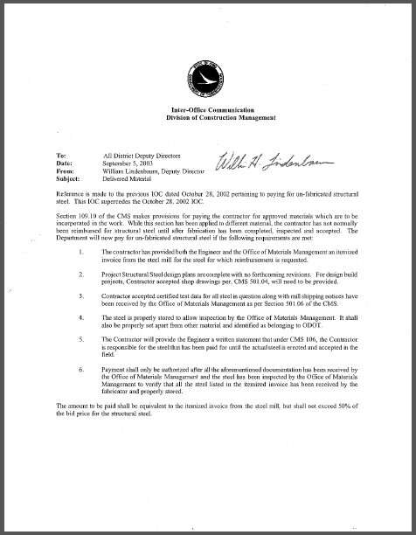
100 Specification Revisions
C&MS 109.10 Payment for Delivered Materials
Include provisions for un-fabricated structural steel
Language from IOC dated 9/15/03 moved to this section

Slide 14
100 Specification Revisions
C&MS 109.10 Payment for Delivered Materials
1. The Contractor has provided both the Engineer and the Office of Materials Management an itemized invoice from the steel mill for the steel for which reimbursement is requested
2. Project structural Steel design plans are complete with no forthcoming revisions. For design build projects, Contractor accepted show drawings per 501.04, will need to be provided
3. Contractor accepted certified test data for all steel in question along with mill shipping notices have been received by the Office of Materials Management per 501.06

Slide 15
100 Specification Revisions
C&MS 109.10 Payment for Delivered Materials
4. The steel is properly stored to allow inspection by the Office of Materials Management. It shall also be properly set apart from other material and identified as belonging to ODOT
5. The Contractor will provide the Engineer a written statement that under 106, the Contractor is responsible for the steel that has been paid for until the actual steel is erected and accepted in the field

Slide 16
100 Specification Revisions
C&MS 109.10 Payment for Delivered Materials
6. Payment shall only be authorized after all the aforementioned documentation has been received by the Office of Materials Management and the steel has been inspected by the Office of Materials Management to verify that all steel listed in the itemized invoice has been received by the fabricator and properly stored. The amount to be paid shall be equivalent to the itemized invoice from the steel mill, but shall not exceed 50% of the bid price for the structural steel

Slide 17
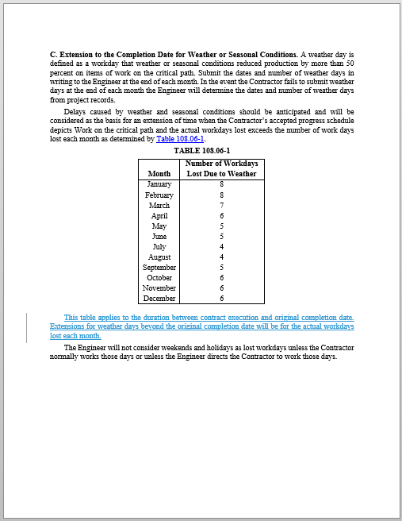
100 Specification Revisions
C&MS 108.06.C Extension to the Completion Date for Weather or Seasonal Conditions
Added language
“This table applies to the duration between contract execution and original completion date. Extensions for weather days beyond the original completion date will be for the actual workdays lost each month.”

Slide 18
100 Specification Revisions
107.15 Contractor’s Responsibility for Work. Until the Final Inspector accepts the Work during the Final Inspection according to 109.12.A, the Contractor is responsible for the Project and will take every precaution against injury or damage to any part thereof by the action of the elements or from any other cause, whether arising from the execution or from the non-execution of the Work. Rebuild, repair, restore, and make good all injuries or damages to any portion of the Work occasioned by any of the above causes before final acceptance. Bear the expense of the repairs except when damage to the Work was due to unforeseeable causes beyond the control of and without the fault or negligence of the Contractor., Unforeseeable causes includeincluding but are not restricted to; (a) earthquake, floods, tornados, high winds, lightning or other catastrophes proclaimed a disaster or emergency, weather, (b) slides, (c) civil disturbances, or (d) governmental acts.
Notes:
107.15 Contractor’s Responsibility for Work. Until the Final Inspector accepts the Work during the Final Inspection according to 109.12.A, the Contractor is responsible for the Project and will take every precaution against injury or damage to any part thereof by the action of the elements or from any other cause, whether arising from the execution or from the non-execution of the Work. Rebuild, repair, restore, and make good all injuries or damages to any portion of the Work occasioned by any of the above causes before final acceptance. Bear the expense of the repairs except when damage to the Work was due to unforeseeable causes beyond the control of and without the fault or negligence of the Contractor., Unforeseeable causes includeincluding but are not restricted to; (a) earthquake, floods, tornados, high winds, lightning or other catastrophes proclaimed a disaster or emergency, weather, (b) slides, (c) civil disturbances, or (d) governmental acts.

Slide 19
100 Specification Revisions
109.05.C.9. Professional and Specialized Work. The following work, when performed by a firm hired by the Contractor, is paid at the reasonable and fair market invoiced cost plus 8% on the first $10,000 of work and 5% for work in excess of $10,000plus a 5 percent markup. The markup is limited to $10,000 for all the work performed by the firm.
a. Surveying
b. Engineering design
c. Specialized work that is not normally part of a Department Contract and is not normally subject to prevailing wage
d. Installation, periodic maintenance, and removal of traffic control devices under Item 614 performed by a traffic control service or rental company, provided the workers are not on the Project full-time. Maintenance of Traffic services performed by LEO
e. Other professional or specialized work not contemplated at the time of Bid
Provide documentation showing payment for professional and specialized Work
Notes:
109.05.C.9. Professional and Specialized Work. The following work, when performed by a firm hired by the Contractor, is paid at the reasonable and fair market invoiced cost plus 8% on the first $10,000 of work and 5% for work in excess of $10,000plus a 5 percent markup. The markup is limited to $10,000 for all the work performed by the firm.
a. Surveying.
b. Engineering design.
c. Specialized work that is not normally part of a Department Contract and is not normally subject to prevailing wage.
d. Installation, periodic maintenance, and removal of traffic control devices under Item 614 performed by a traffic control service or rental company, provided the workers are not on the Project full-time. Maintenance of Traffic services performed by LEO.
e. Other professional or specialized work not contemplated at the time of Bid.
Provide documentation showing payment for professional and specialized Work.

Slide 20
100 Specification Revisions
109.05.D.2.g. Subsistence and Travel Allowance. The Department will pay costs for subsistence and travel allowances for labor that must remain on the Project during the delays, when such payments are required by the collective bargaining agreement or other employment contracts applicable to the classes of labor employed on the project. Overnight lodging will be reimbursed if the person is at a location greater than forty-five miles from their residence up to a maximum of $106 per day. Meals and incidental expenses will reimbursed up to a maximum of $56 per day. The Department will not pay a percent markup on these costs.
Notes:
109.05.D.2.g. Subsistence and Travel Allowance. The Department will pay costs for subsistence and travel allowances for labor that must remain on the Project during the delays, when such payments are required by the collective bargaining agreement or other employment contracts applicable to the classes of labor employed on the project. Overnight lodging will be reimbursed if the person is at a location greater than forty-five miles from their residence up to a maximum of $106 per day. Meals and incidental expenses will reimbursed up to a maximum of $56 per day. The Department will not pay a percent markup on these costs. OBM Travel Rule for overnight lodging
US General Services Administration FY2015 Per Diem Rate for Columbus, Ohio. Referenced by OBM Travel Rule.
US General Services Administration FY2015 Per Diem Rate for Columbus, Ohio. Referenced by OBM Travel Rule.

Slide 21
CY2014 Change Order QAR’s
All Districts are conducting the day to day business of processing change order in accordance with the Department’s policy and standard procedure
Almost all QAR’s were attended by FHWA

Slide 22
CY2014 Change Order QAR’s
Work added or modifications to the Contract Documents made by change order must be only those which are necessary and integral to the completion of the project as intended by the original plan
Added work must be within the existing Right-of-Way, covered by the approved environmental document and waterway and miscellaneous permits, and within the project limits stated in the plans
Each District shall develop and implement a collaborative process whereby the Planning and Engineering Office, Highway Management Office and the Construction Office reach consensus on the need for a change order before it is recommended in SiteManager
Notes:
All in all the change order were compliant. In a separate FHWA Program Review, it was recommended that the explanation of necessity could be strengthened or improved.

Slide 23
FY2014 Change Order Data
Original Contract Amount $5,081,550,076
Change Orders
Preventable $16,300,239
Non-preventable $5,478,933
Price Adjustments $2,285,648
Change Order Percentage 0.5%

Slide 24
CY2014 Defaults
Scenario #1
Construction of ODOT truck maintenance facility
Contractor does not proceed with the Work in a manner necessary for completion of the Project by the Completion Date
Contractor not paying subcontractors
Construction approximately 90% complete
Default letter sent to Surety
Surety provided a replacement contractor to finish the work and pay subcontractors for work completed

Slide 25
CY2014 Defaults
Scenario #2
Bridge maintenance contract for various structures in the District
Contractor Superintendent investigated by the Department of Labor
Contractor does not proceed with the Work in a manner necessary for completion of the Project by the Completion Date
Contractor fails to provide a plan to complete the Work
Construction approximately 72% complete
Letter sent to Surety
Surety provided a replacement contractor to finish the work

Slide 26
CY2014 Defaults
Scenario #3
Contractor had two District wide mowing contracts
VA-MOW-FY2013-2014
MOWA – FY2014-2015
Contractor voluntarily defaulted
Department met with Surety
Surety rebid the remaining Work
Surety provided additional monies to complete the Work
Waiver of competitive bid approved by Controlling Board
Replacement contractor completed one project and is working to complete the other project

Slide 27
Contractor Invoicing
Special Provision
The Department will not pay an estimate until the Contractor submits an invoice, quantity documentation, and certifies to the Engineer that the work for which payment is being made was performed in accordance with the contract. The invoice and certification will be made on forms provided by the Department

Slide 28
Contractor Invoicing
Special Provision, con’t
The Department will perform quality assurance reviews on a minimum of 10% of the total project reference items to include, but not limited to, the higher cost, higher risk bid items pre-selected by the Engineer to validate the contractor's invoices

Slide 29
Contractor Invoicing
Pilot Projects
Each District (24 total)
Simplified Plan Expedited Delivery (SPEDuP) only
simple, low risk projects
Goal
Additional pilots would also expose more District personnel and contractors to the concept
More data points to determine the impact on
time savings and/or CE&I costs
Notes:
There will be evaluations at the mid-point and end of every project.
Evaluations completed by both the District and the Contractor

Slide 30
Contractor Invoicing – Preliminary Data
Notes:
This is TMS data. EIMS data not available at this time.

Slide 31
Contractor Invoicing – Preliminary Data
The pilot program did not work well with the pavement marking contract. I spent too much time getting estimate quantities and the daily forms to match. The contractor's office worked with me through back and forth emails but it was still frustrating and time consuming
From the contractor’s perspective, this is a huge change for field and office personnel alike, and we really do not understand the need for it
The team members in District One were very professional and easy to work with on this project. I look forward to the chance to work with them again in the future

Slide 32
Contractor Invoicing – Preliminary Data
Poor fit for pavement marking contracts
Need additional data on CEI costs
Need additional evaluations

Slide 33
Questions?
Contact Information:
Clint Bishop, P.E.
Office of Construction Administration
clint.bishop@dot.state.oh.us

